Slide 1

BY AJAERO IHUOMA, 2023

Slide 2
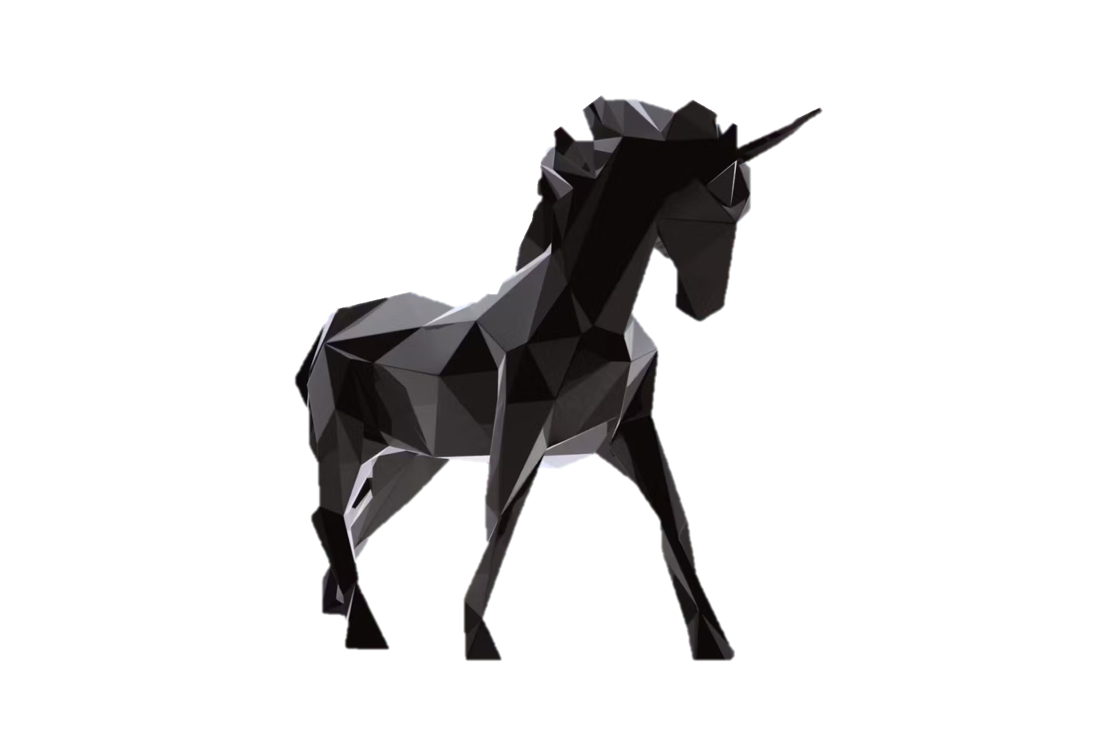
Data Summary
The Dataset used was found on Kaggle.
Columns, null values, unique values and duplicates were duly checked
Right data types
Data Limitations
Dataset is not current. It is 2022, the year is currently 2023.
Absence of relevant data
It contains 10 columns and 1074 rows.
Analyzed using Python
Data Cleaning

Slide 3
Data Dictionary:
Field | Description
Company | Company name
Valuation | Company valuation in billions (B) of dollars
Date Joined | The date in which the company reached $1 billion in valuation
Industry | Company industry
City | City the company was founded in
Country | Country the company was founded in
Continent | Continent the company was founded in
Year Founded | Year the company was founded
Funding | Total amount raised across all funding rounds in billions (B) or millions (M) of dollars
Select Investors | Top 4 investing firms or individual investors (some have less than 4)

Slide 4
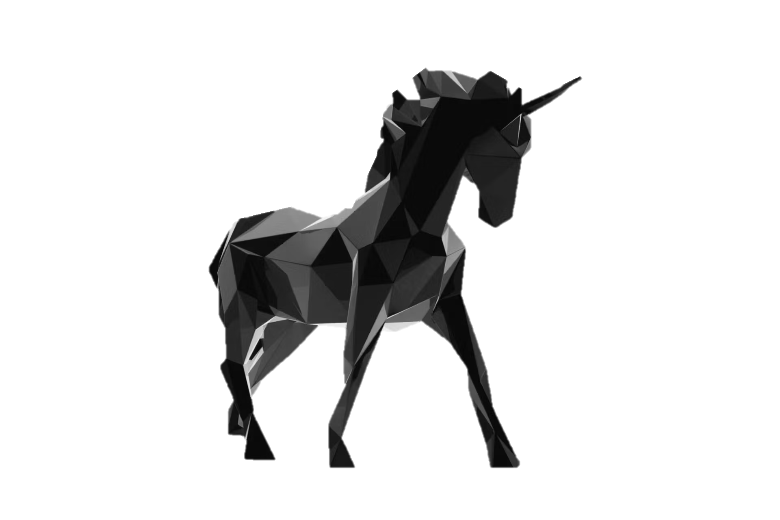
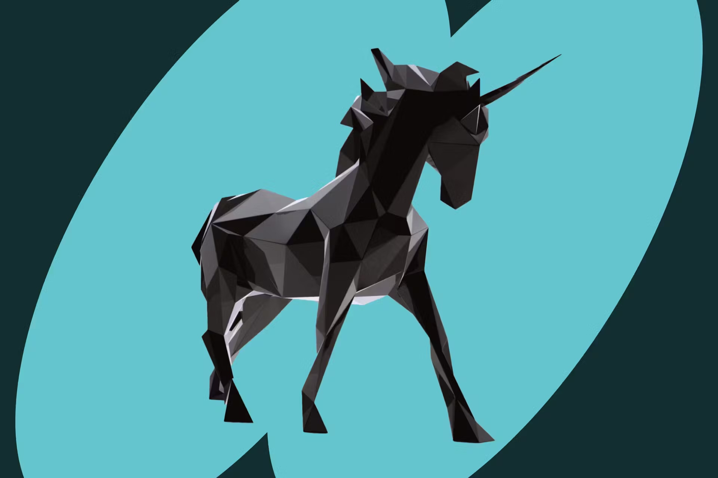
EXPLORATORY DATA ANALYSIS
What are the top 15 companies by valuation
What year did most companies become unicorns
Do older companies have any advantage with age
How long does it usually take a company to become a unicorn?
What industries have the most unicorns
What countries have the most unicorns (Top 5)
In these top 5 countries, what industries are most available
Top 5 cities with the most unicorns
What investors have funded the most Unicorns
Does the amount of funding influence the valuation

Slide 5
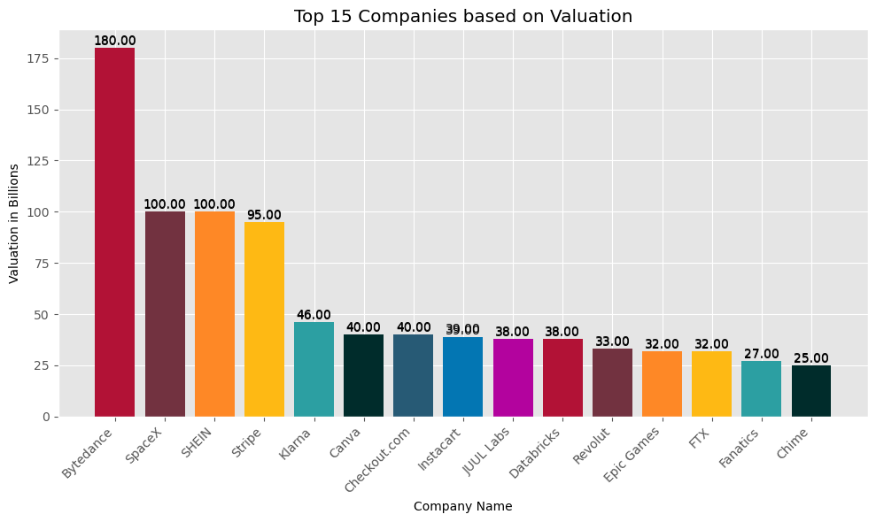
What are the top 15 companies by valuation
Observation:
Bytedance is the most valuable unicorn, worth 180 Billion Dollars, followed by Shein and Spacex, worth 100 Billion Dollars each.

Slide 6
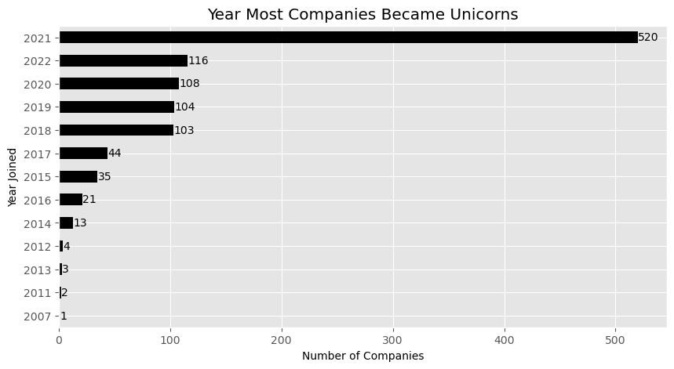
What year did most companies become unicorns
Observation:
Most companies became unicorns in the year 2021, with a total of 520 companies. Followed by 2022 with a total of 116 companies.

Slide 7
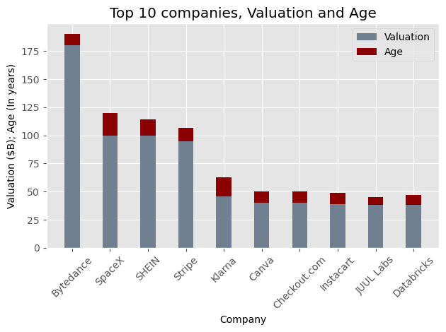
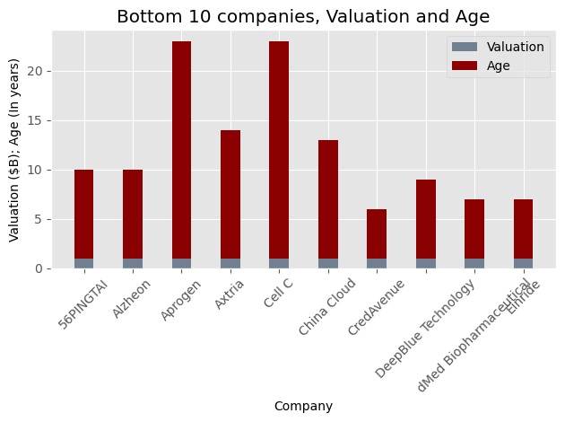
Do older companies have any advantage with age
Observation:
We can see that the companies founded earlier are the lowest in valuation.
Older companies have no advantage with age.

Slide 8
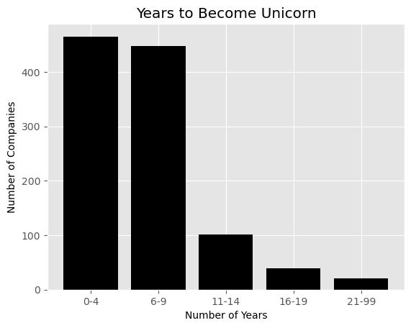
How long does it usually take a company to become a unicorn?
Observation:
Most companies became unicorns within the first 10 years of founding.
Out of the total 1074 companies, 912 became unicorns within the first 10 years, 140 in the first 20 years.

Slide 9
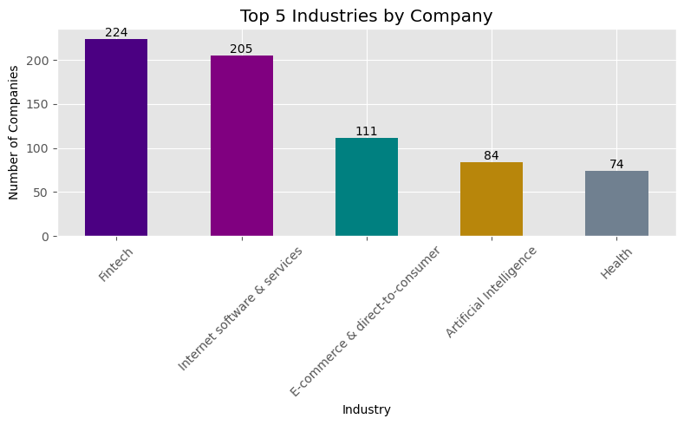
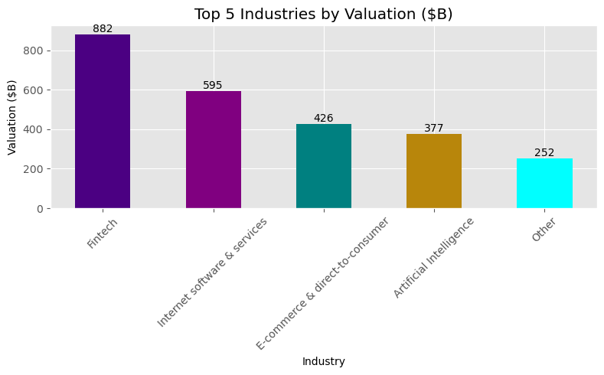
What industries have the most unicorns
The top 5 industries by number of company are Fintech, Internet software & services, E-Commerce & direct-to-consumer, Artificial Intelligence and Health

Slide 10
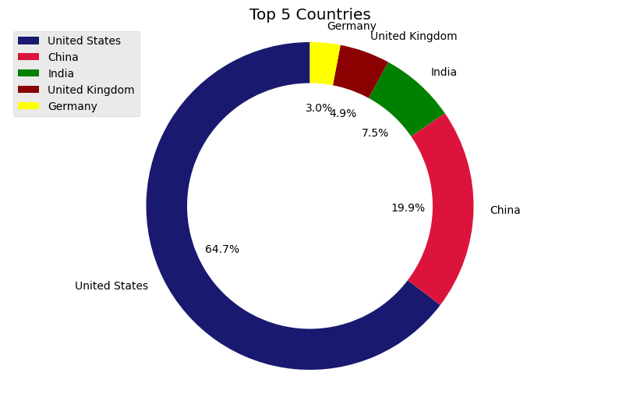
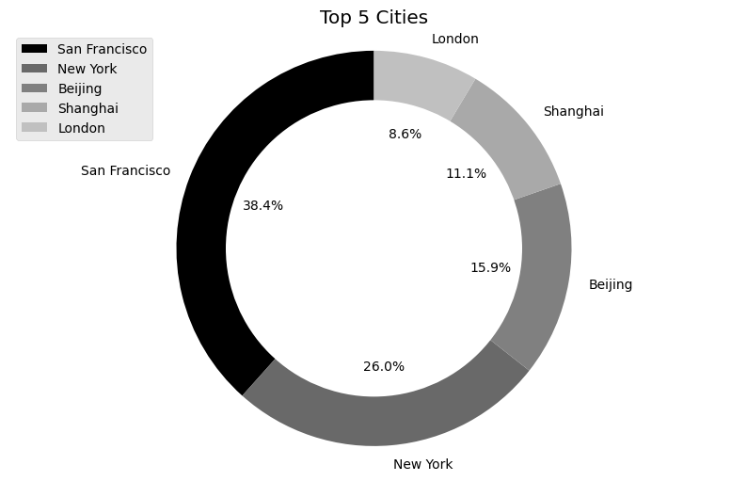
What countries and Cities have the most unicorns
USA is the highest with 562 unicorns.
China has second highest with 173 unicorns.
India closely follows third with 65 unicorns.
United Kingdom has 43 unicorns.
Germany is fifth with 26 unicorns.
San Francisco is the highest with 152 unicorns.
New York closely follows with 103 unicorns.
Beijing follows third with 63 unicorns.
Shanghai is the fourth with 44 unicorns.
London comes fifth with 34 unicorns.

Slide 11
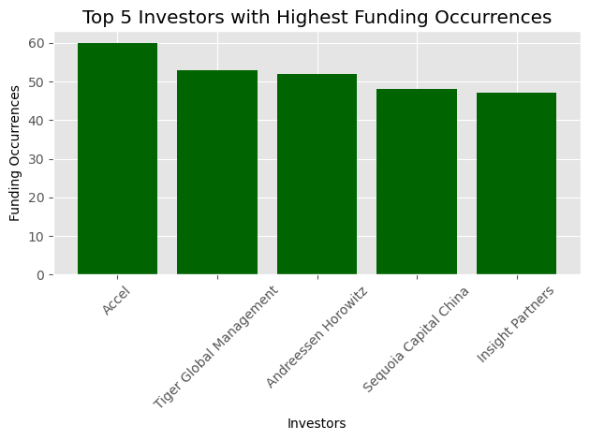
What investors have funded the most Unicorns
Observation:
The top 5 investors include:
Accel,
Tiger Global Management,
Andreessen Horowitz,
Sequoia Capital China,
Insight Partners.

Slide 12
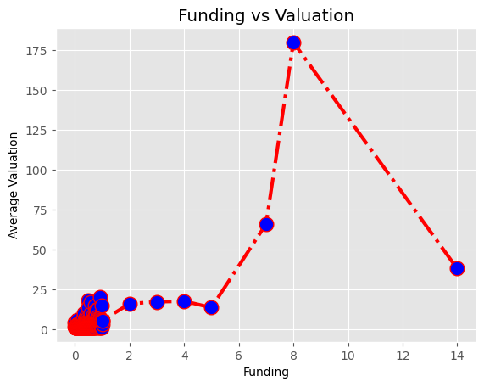
Does the amount of funding influence the valuation
Observation:
There is a positive correlation between funding and valuation.
In the case of JUUL Labs which got the most funding(14B) but drops in valuation; research shows there was an ongoing dispute between JUULS Labs and the USA FDA, leading to a fall in their market share and ultimately stopping the sales of JUUL pods.

Slide 13
GENERAL OBSERVATIONS
There are over 1000+ unicorn companies, located in 46 countries and 256 cities across the world.
These companies are grouped into 16 different industries.
The most valuable unicorn is valued at 180 Billion Dollars ; a company needs to be valued at $1B to be considered a unicorn
It is possible to achieve unicorn status within 2 - 4 years of founding. On average, it takes 7 years to become a unicorn.
Fintech is the most valued industry, followed by Internet Software Service, E-Commerce & direct-to-consumer, Artificial Intelligence, and Health.
United States houses 64.7% of unicorns. San Francisco and New York are the cities with the most unicorns in the world.
The amount of funding from investors positively influences the development of a unicorn.

Slide 14
RECOMMENDATIONS
There should be a good relationship with the right investors in your industry. There are investor hubs like 'Kickstarter' to be a part of to build these networks.
The top industries show where the interest of the people lie. Therefore, there will be more investors willing to fund start-ups in those areas.
More start-ups needs to feed into the tech space and discover how to solve consumer problems with the use of technology. This is a fast-growing industry. Try to be unique and bring something different into the tech space.
It is advisable to discover a large homogenous potential market in order to drive more engagement. Define your audience and market strategically.
A good business model, strategy, and vision designed for rapid growth is necessary for becoming a unicorn.

Slide 15
THANK YOU FOR YOUR TIME!

